Slide 1
Introduction to Web Development Part 3: Demo NodeJs Rest Api
arnaud.nauwynck@gmail.com
Course Esilv 2023
This document: https://github.com/Arnaud-Nauwynck/presentations/web/angular-demos-3-nodejs-rest-api.pdf

Slide 2
Demo Outline
Reminder : http client/server, SPA: Single Page Application
Classical Web app tutorial: « Todo web application »
Setup NodeJs + Express
CRUD Rest endpoints :
POST « /todo » {json}
GET « /todo »
GET « /todo/:id »
PUT « /todo » {json}
DELETE « /todo/:id »
Test using Curl
Test using Postman
OpenApi – Swagger UI

Slide 3
SPA = Single Page Application single GET {html|js}, Multiple Rest Json requests
Web Browser
Reminder
/Page1.html
http GET /page1.html
<script>app1.js</script>
http GET /page1.js
app1.js
Parse js
+ execute function init() {.. }
+ parse css + render html
http GET /page1.css
http GET /page1-image2.png
Web Server
CLICK on <button (click)=« callFunction() » >
http POST /api/restEndpoint1 {json}
REPLACE add/remote/update some <div>
Within SAME page
response {json}
http POST /api/restEndpoint2 {json}
response {json}

Slide 4
Rest using NodeJs - Express
Reminder
const express = require('express');
const app = express();
app.get('/', function (req, res) {
res.send({ some: 'Hello Json Express' })
});
app.listen(3000);

Slide 5
~ Rest using Springboot: @RequestMapping
Reminder
http PUT /api/endpoint1/meth2
header1:value1
{
« reqField »: « value»
}
class RequestDTO {
public String reqField;
}
Json -> java
@RestController
@RequestMapping(« /api/endpoint1 »)
public class MyRestController {
@PutMapping(« meth2»)
public ResponseDTO handle( @RequestBody RequestDTO req) {
return new …
}
}
http 200 OK
header2:value2
{
« respField »: « value»
}
Java -> json
class ResponseDTO {
public String respField;
}

Slide 6
Ng serve… why Proxy to /api/** ? => CORS Origin problem !
Reminder
Because … Web Browser blocks calls to « http://localhost:8080/api/** »
not comming from same « origin domain » as « http://localhost:4000/index.html » «app.js » !
ng serve
Web Browser
static *.html,*.js
:4000
conf/proxy.json (or .js) redirect /api/**
to localhost:8080/api/
Backend server
:8080
Blocked: CORS origin

Slide 7
Demo Outline
Reminder : http client/server, SPA: Single Page Application
Classical Web app tutorial: « Todo web application »
Setup NodeJs + Express
CRUD Rest endpoints :
POST « /todo » {json}
GET « /todo »
GET « /todo/:id »
PUT « /todo » {json}
DELETE « /todo/:id »
Test using Curl
Test using Postman
OpenApi – Swagger UI

Slide 8
Web Site Sketch -> Discover API requirement
New Form Page
Update Form Page
Update TODO - id : 1234
Description :
Priority:
Description :
Priority:
Home Page
Save
Update
New…
List
List Page
Readonly Detail Page
id : 1
Description : Todo 1
Priority: 2
(id1) Todo 1
Del
Detail
(id2) Todo 2
Del
Detail
List
Edit

Slide 9
App Skeleton Buttons : Action / Query - Navigation
Button type Action => Execute Action on Server
= http POST, PUT, DELETE
Some Button
Button type Query / Refresh => Execute Query on Server = http GET
Button type Navigation => load page data = execute query
= http GET

Slide 10
Todo Web App API Description … CRUD
C Create
R Read All
Read By Id
U Update
D Delete
Page 1: Simple Html Form with input fields
Click on « Save » button => save « Todo » object on server
Page 2: Show list of « Todos »
page 3 for url « /todo/{id} »
Show detailed « Todo» page
Page 4: Editable page + « update » button
« delete » button

Slide 11
Demo Outline
Reminder : http client/server, SPA: Single Page Application
Classical Web app tutorial: « Todo web application »
Setup NodeJs + Express
CRUD Rest endpoints :
POST « /todo » {json}
GET « /todo »
GET « /todo/:id »
PUT « /todo » {json}
DELETE « /todo/:id »
Test using Curl
Test using Postman
OpenApi – Swagger UI

Slide 12
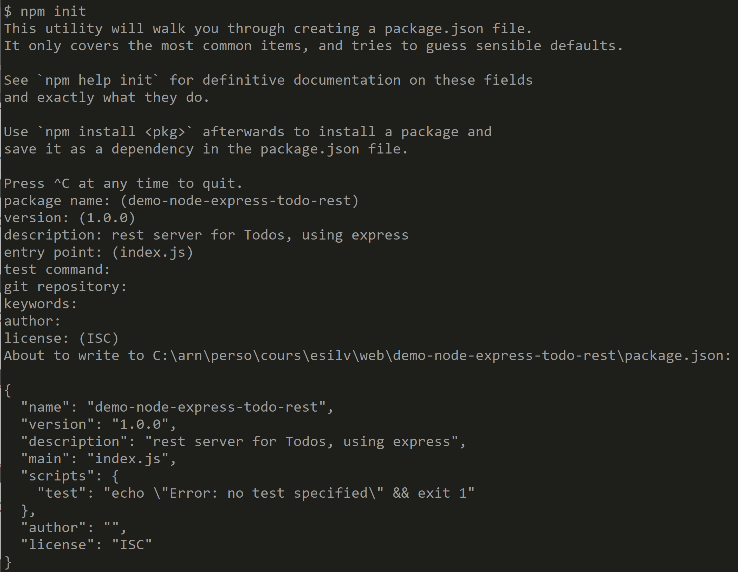
$ npm init

Slide 13
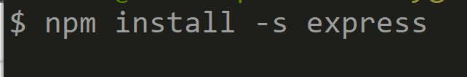
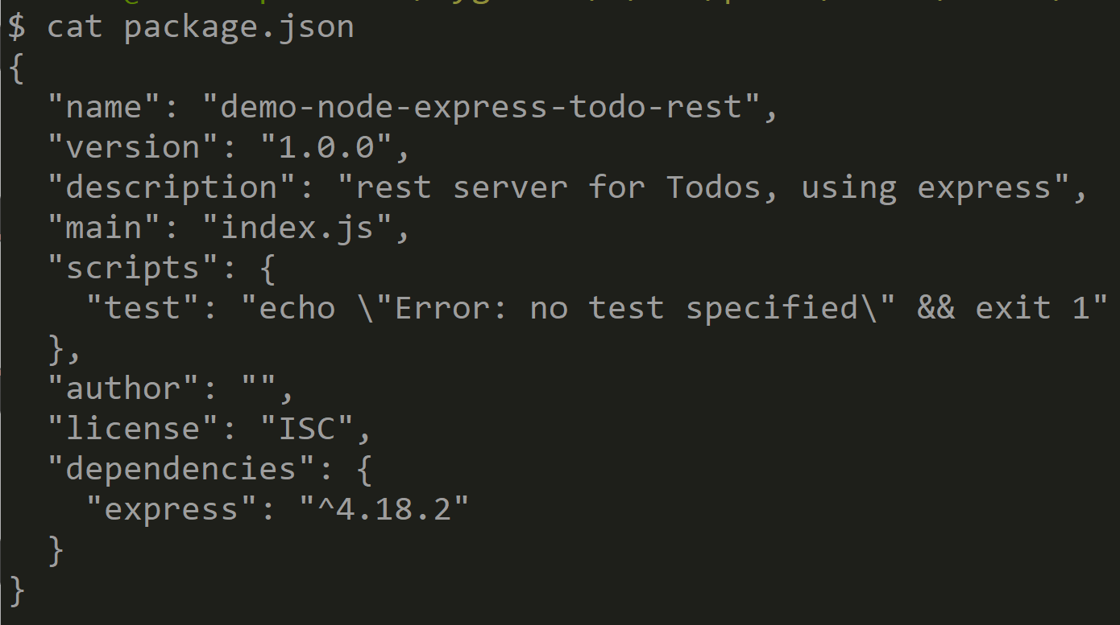
$ npm install –s express

Slide 14
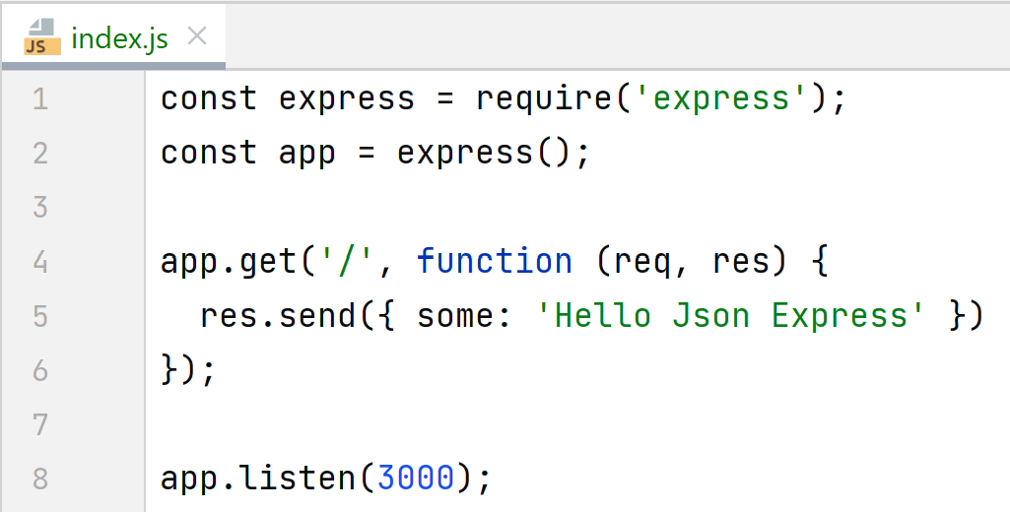
Hello express endpoint (port 3000)

Slide 15
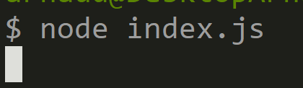
Running: $ node index.js

Slide 16
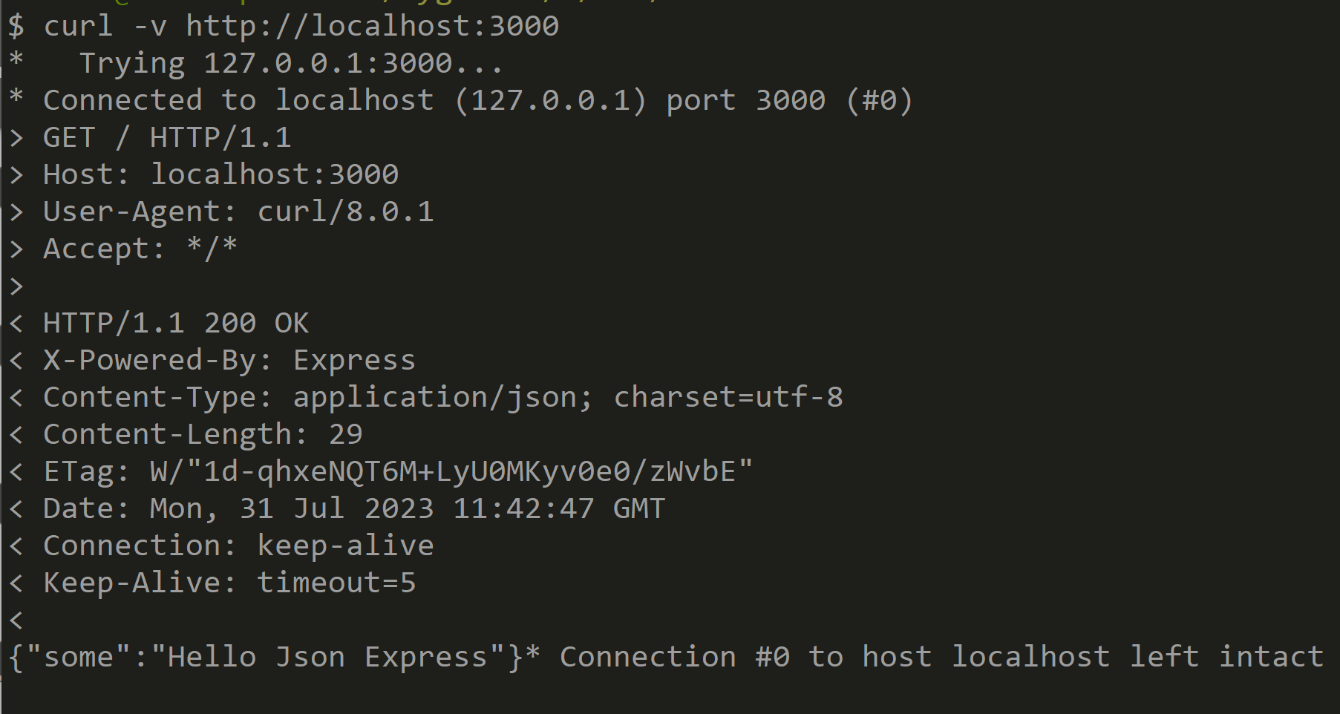
Test using Curl

Slide 17
Demo Outline
Reminder : http client/server, SPA: Single Page Application
Classical Web app tutorial: « Todo web application »
Setup NodeJs + Express
CRUD Rest endpoints :
POST « /todo » {json}
GET « /todo »
GET « /todo/:id »
PUT « /todo » {json}
DELETE « /todo/:id »
Test using Curl
Test using Postman
OpenApi – Swagger UI

Slide 18
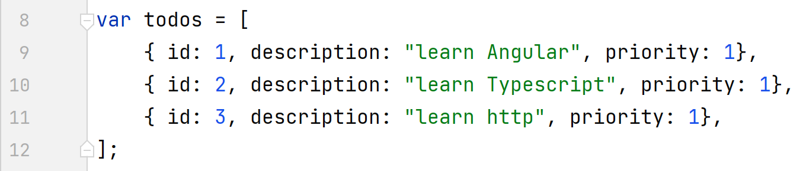
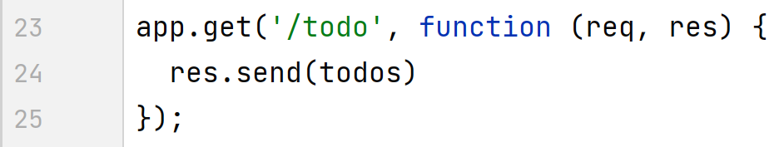
Rest endpoint : GET « /todo »

Slide 19
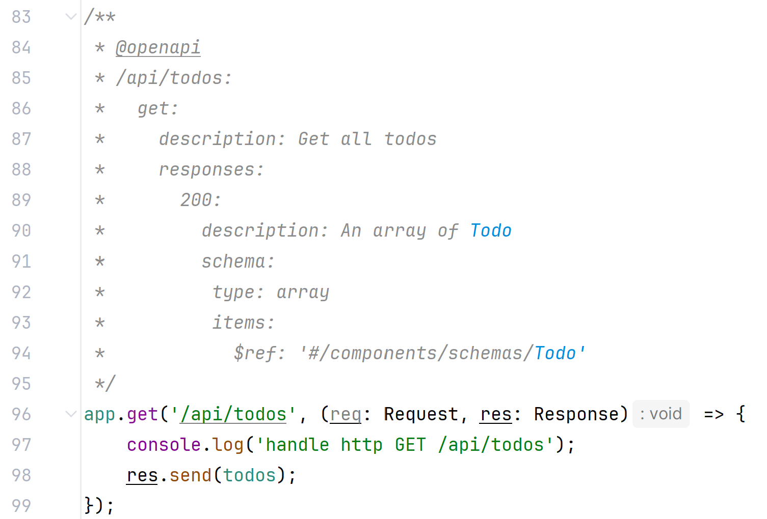
GET "/api/todos" with OpenApi (swagger) doc
With OpenAPI

Slide 20
WHY is this JsDoc necessary ?
OpenApi (see next) is generally mandatary in modern IT departments
OpenApi when using NodeJS-Express is unable
to extract Type Information
from generic method .get( (req, resp) => callback )

Slide 21
More Doc Comment than (TypeScript)Code ! but Comment are untyped/unchecked
Comment are unchecked
NO Tool to validate the syntax / structure of comments
Comment is NOT in-sync with code,
"Json" types in the comment may not reflect the real "type" in TypeScript code
... Difficult to maintain

Slide 22
Spoiler Alert: NodeJS Rest API are Dead, Long Life Java SpringBoot Rest API or Java Quarkus, or C#, ..

Slide 23
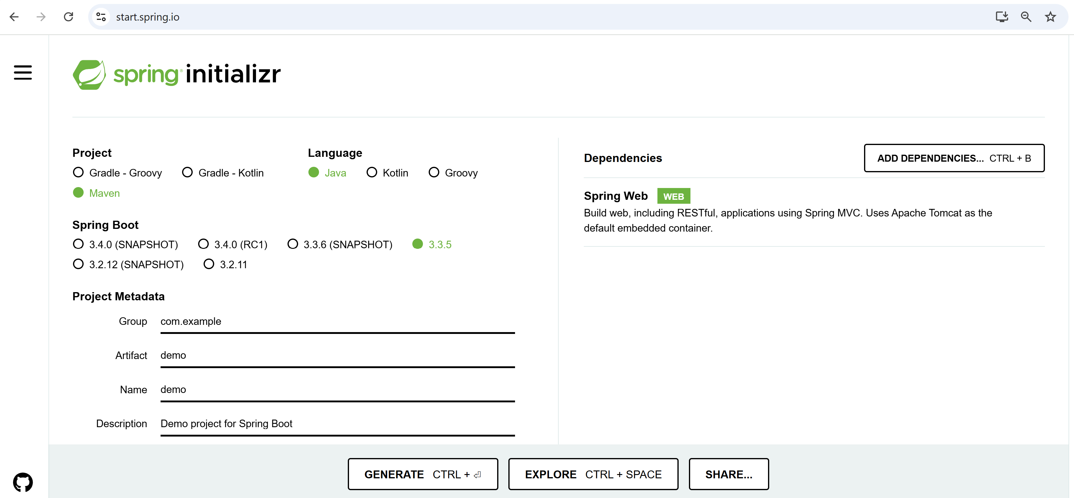
Creating a Java Springboot Rest API
SpringBoot

Slide 24
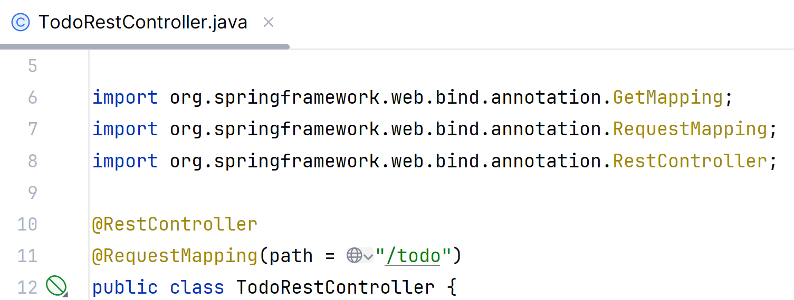
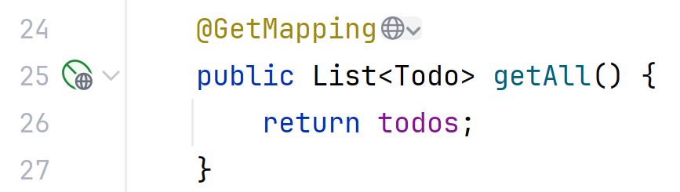
@RestController("/todo") class .. @GetMapping("/") method() {.. }
SpringBoot
in NodeJS-Express
but WITHOUT OpenAPI types
in Java SpringBoot
and WITH types

Slide 25
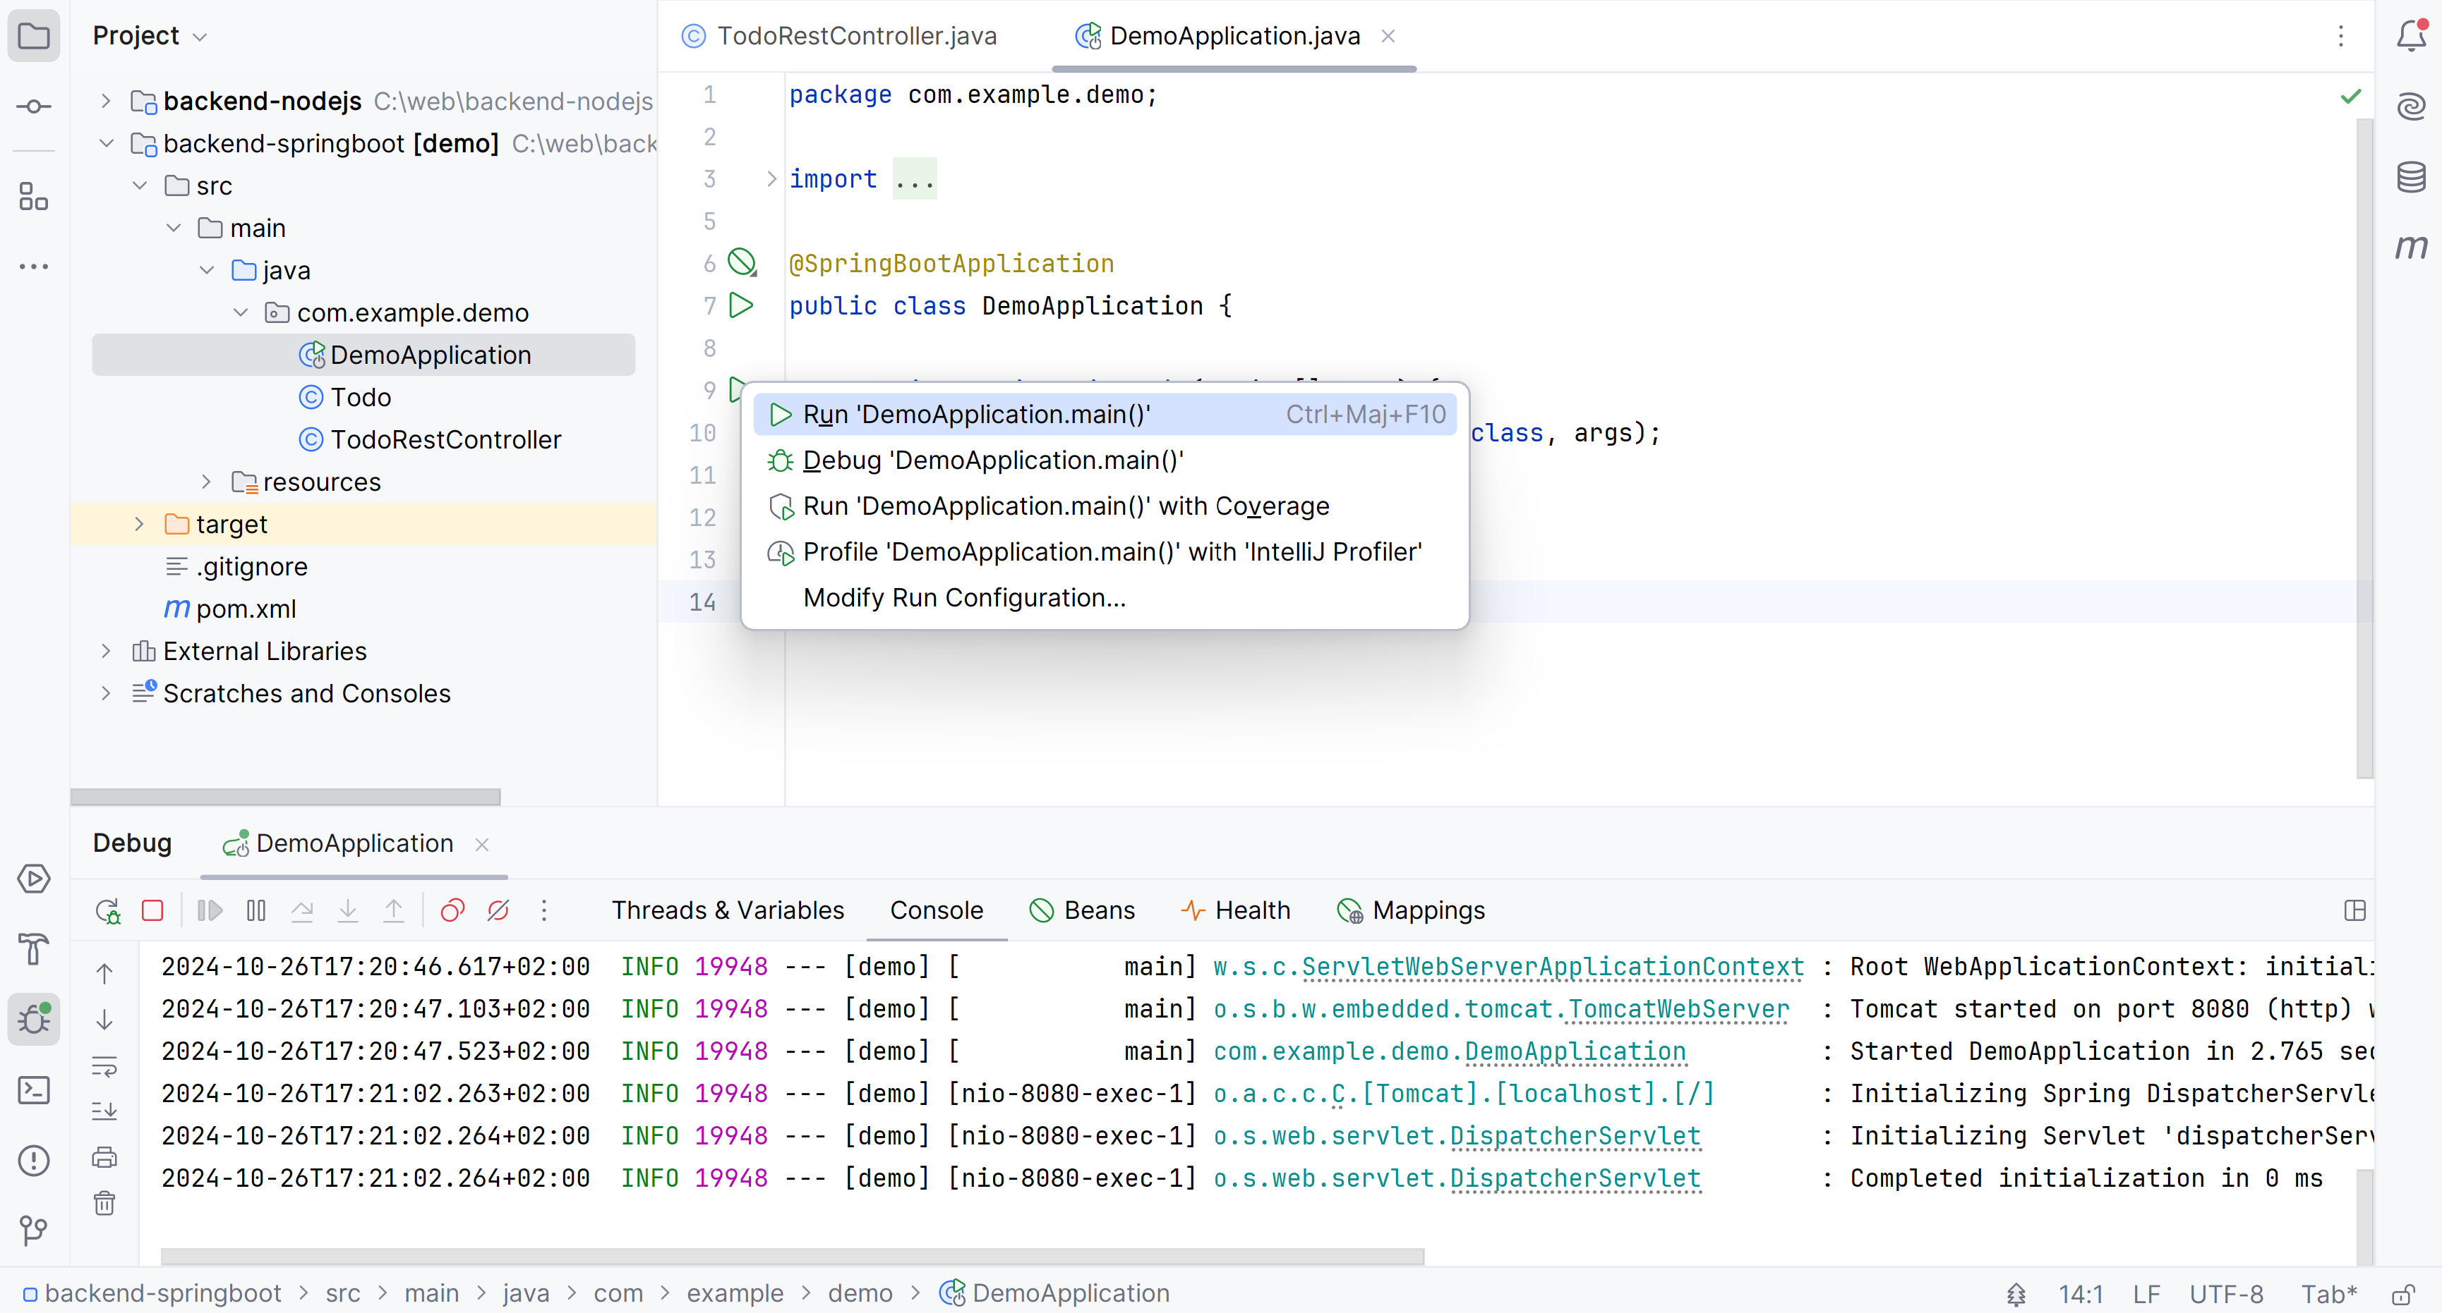

SpringBoot : RUN Application.main()
SpringBoot

Slide 26

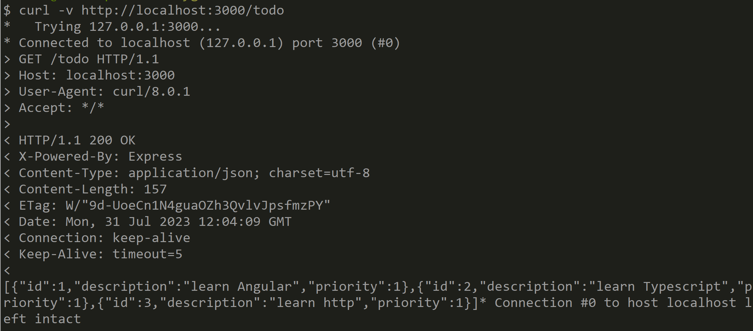
Test GET /todo using curl

Slide 27
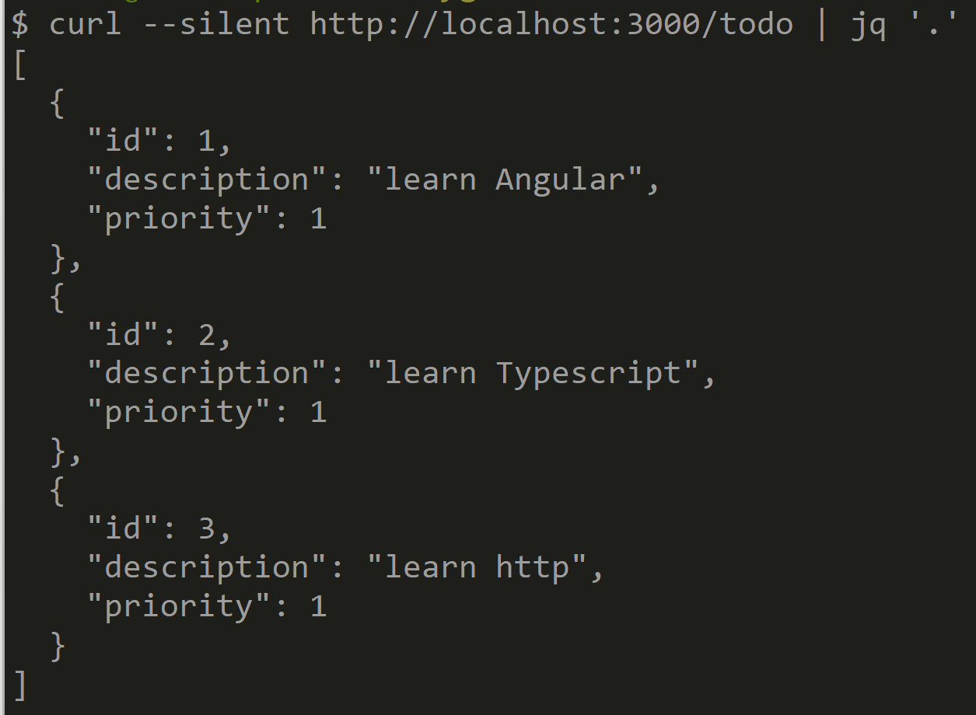
Test GET /todo, using curl --silent + jq ‘.’

Slide 28
Demo Outline
Reminder : http client/server, SPA: Single Page Application
Classical Web app tutorial: « Todo web application »
Setup NodeJs + Express
CRUD Rest endpoints :
POST « /todo » {json}
GET « /todo »
GET « /todo/:id »
PUT « /todo » {json}
DELETE « /todo/:id »
Test using Curl
Test using Postman
OpenApi – Swagger UI

Slide 29
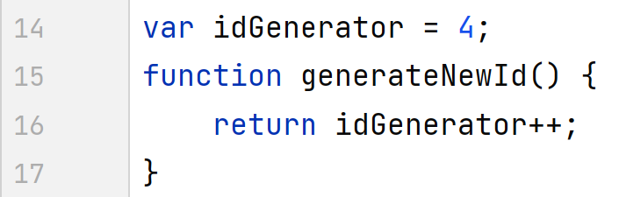
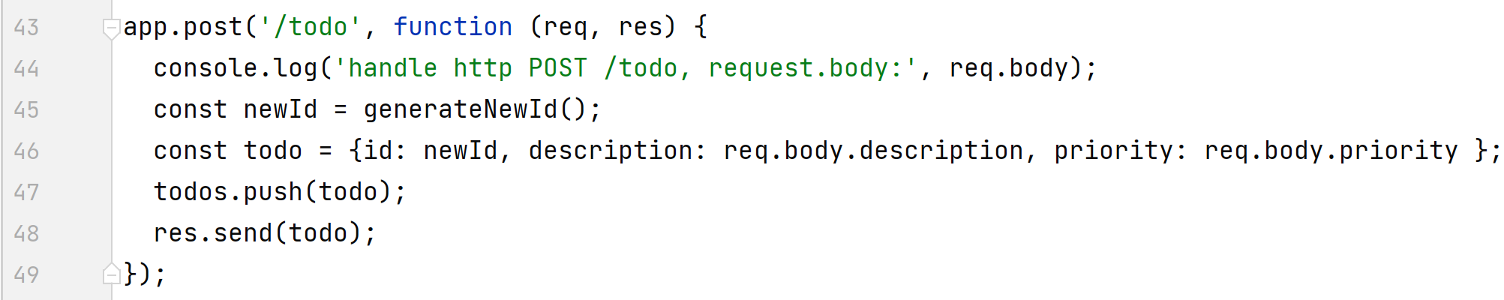
Rest endpoint POST /todo

Slide 30
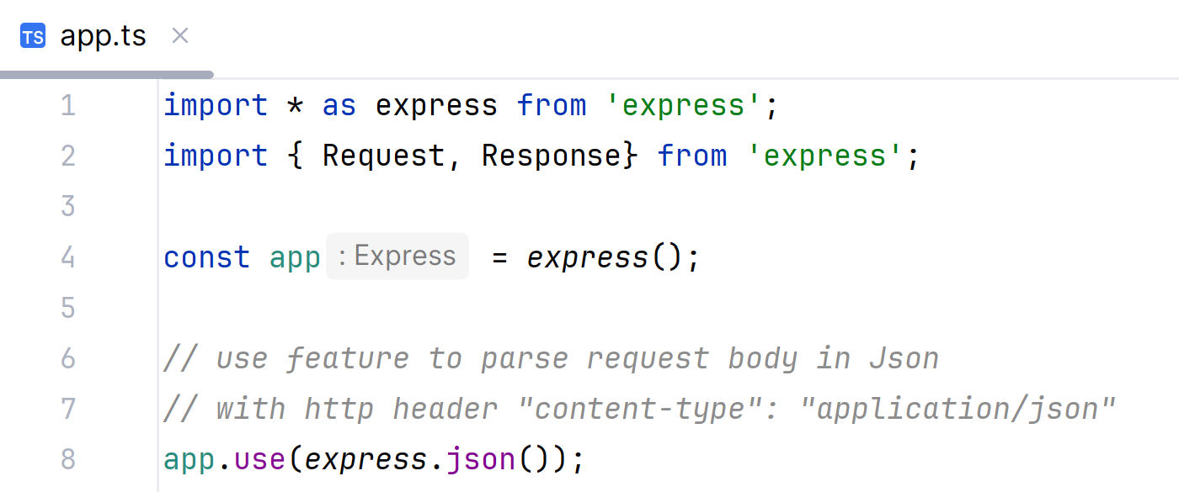
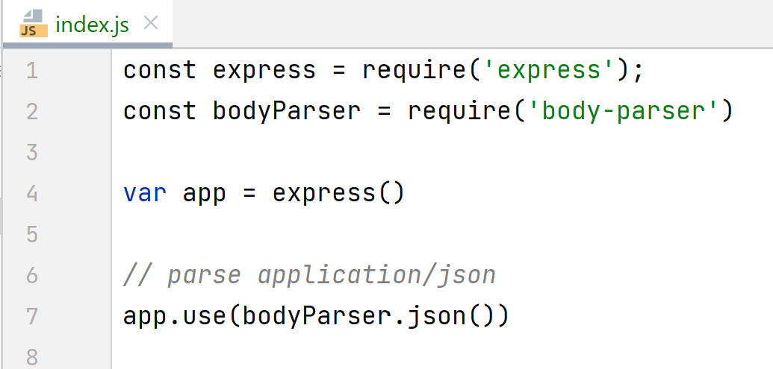
use Express Json
( older Deprecated way )

Slide 31

Test using curl … -H « Content-Type: application/json » -H « accept: application/json » -d ’{« description»: « ..» }’

Slide 32


console.log() in nodejs

Slide 33
Demo Outline
Reminder : http client/server, SPA: Single Page Application
Classical Web app tutorial: « Todo web application »
Setup NodeJs + Express
CRUD Rest endpoints :
POST « /todo » {json}
GET « /todo »
GET « /todo/:id »
PUT « /todo » {json}
DELETE « /todo/:id »
Test using Curl
Test using Postman
OpenApi – Swagger UI

Slide 34
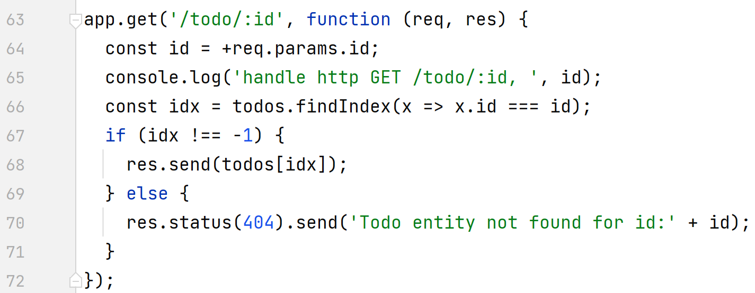
Rest endpoint GET « /todo/:id »

Slide 35
Notice… type coercion, exact === vs ==
const id = +req.param.id; // <= coercion string to number
// equivalent to:
const idText = req.param.id; // idText is string
const id = +idText; // id is number
(id === 2) // correct, exact equality for number
(id === ‘2’) // wrong… types differ
(id == ‘2’) or (id == 2); // both ok, using implicit type coercions

Slide 36
Demo Outline
Reminder : http client/server, SPA: Single Page Application
Classical Web app tutorial: « Todo web application »
Setup NodeJs + Express
CRUD Rest endpoints :
POST « /todo » {json}
GET « /todo »
GET « /todo/:id »
PUT « /todo » {json}
DELETE « /todo/:id »
Test using Curl
Test using Postman
OpenApi – Swagger UI

Slide 37
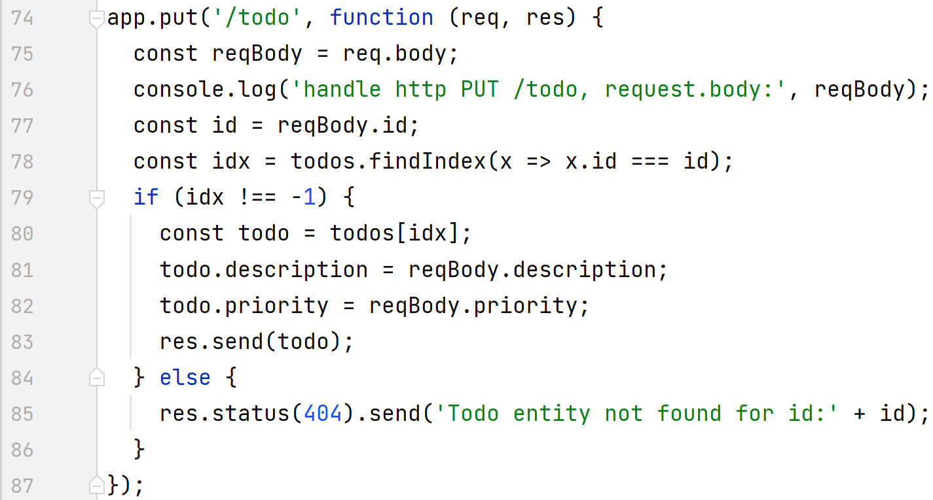
Rest endpoint PUT « /todo » req.body={ id:.., ..}

Slide 38
Demo Outline
Reminder : http client/server, SPA: Single Page Application
Classical Web app tutorial: « Todo web application »
Setup NodeJs + Express
CRUD Rest endpoints :
POST « /todo » {json}
GET « /todo »
GET « /todo/:id »
PUT « /todo » {json}
DELETE « /todo/:id »
Test using Curl
Test using Postman
OpenApi – Swagger UI

Slide 39
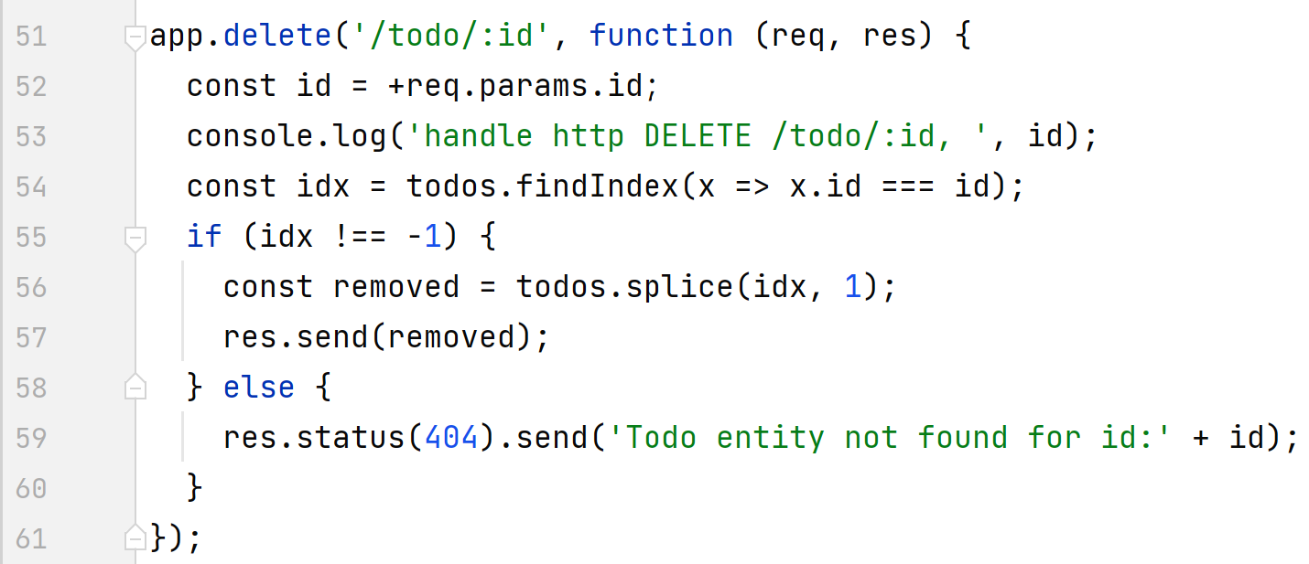
Endpoint DELETE « /todo/:id »

Slide 40

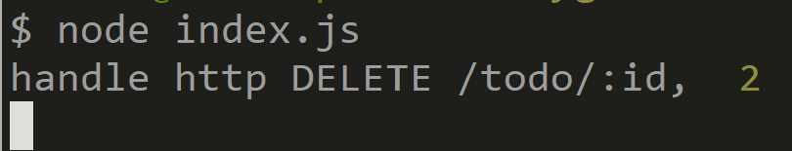

Test Endpoint DELETE « /todo/:id »

Slide 41
Demo Outline
Reminder : http client/server, SPA: Single Page Application
Classical Web app tutorial: « Todo web application »
Setup NodeJs + Express
CRUD Rest endpoints :
POST « /todo » {json}
GET « /todo »
GET « /todo/:id »
PUT « /todo » {json}
DELETE « /todo/:id »
Test using Curl
Test using Postman
OpenApi – Swagger UI

Slide 42
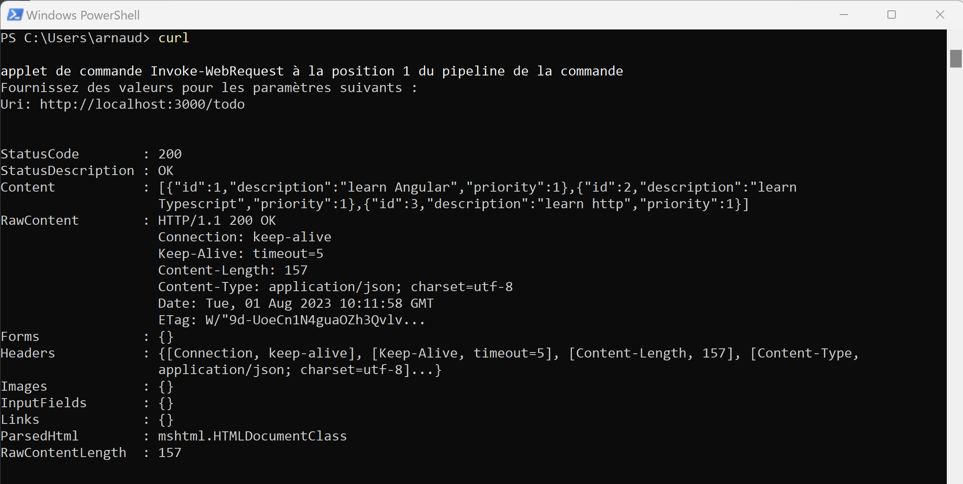
$ curl … c:> ?? PS1> Invoke-WebRequest
Curl on Power-Shell = alias for Invoke-WebRequest
… different command line arguments / result formatting !

Slide 43
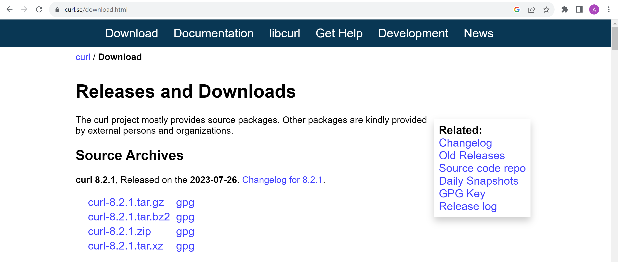
https://curl.se/download.html

Slide 44
$ curl sheet cheat
-X GET,POST,PUT,DELETE
Default: GET when no -d
Or POST when –d ’request body’
-d ’request body’
@ : request body from file name
Example: $ curl –X POST http://loc @file.json
@- : request body from stdin
Example: $ cat << EOF
{ «field »: 123 }
EOF | curl –X POST http://loc @-
-v verbose
>
> Sent
<
< Received
-H header:value
Example:
-H Content-Type:application/json
-H Accept:application/json
-u user:password
-x proxy or export HTTPS_PROXY
--silent

Slide 45
Demo Outline
Reminder : http client/server, SPA: Single Page Application
Classical Web app tutorial: « Todo web application »
Setup NodeJs + Express
CRUD Rest endpoints :
POST « /todo » {json}
GET « /todo »
GET « /todo/:id »
PUT « /todo » {json}
DELETE « /todo/:id »
Test using Curl
Test using Postman
OpenApi – Swagger UI

Slide 46
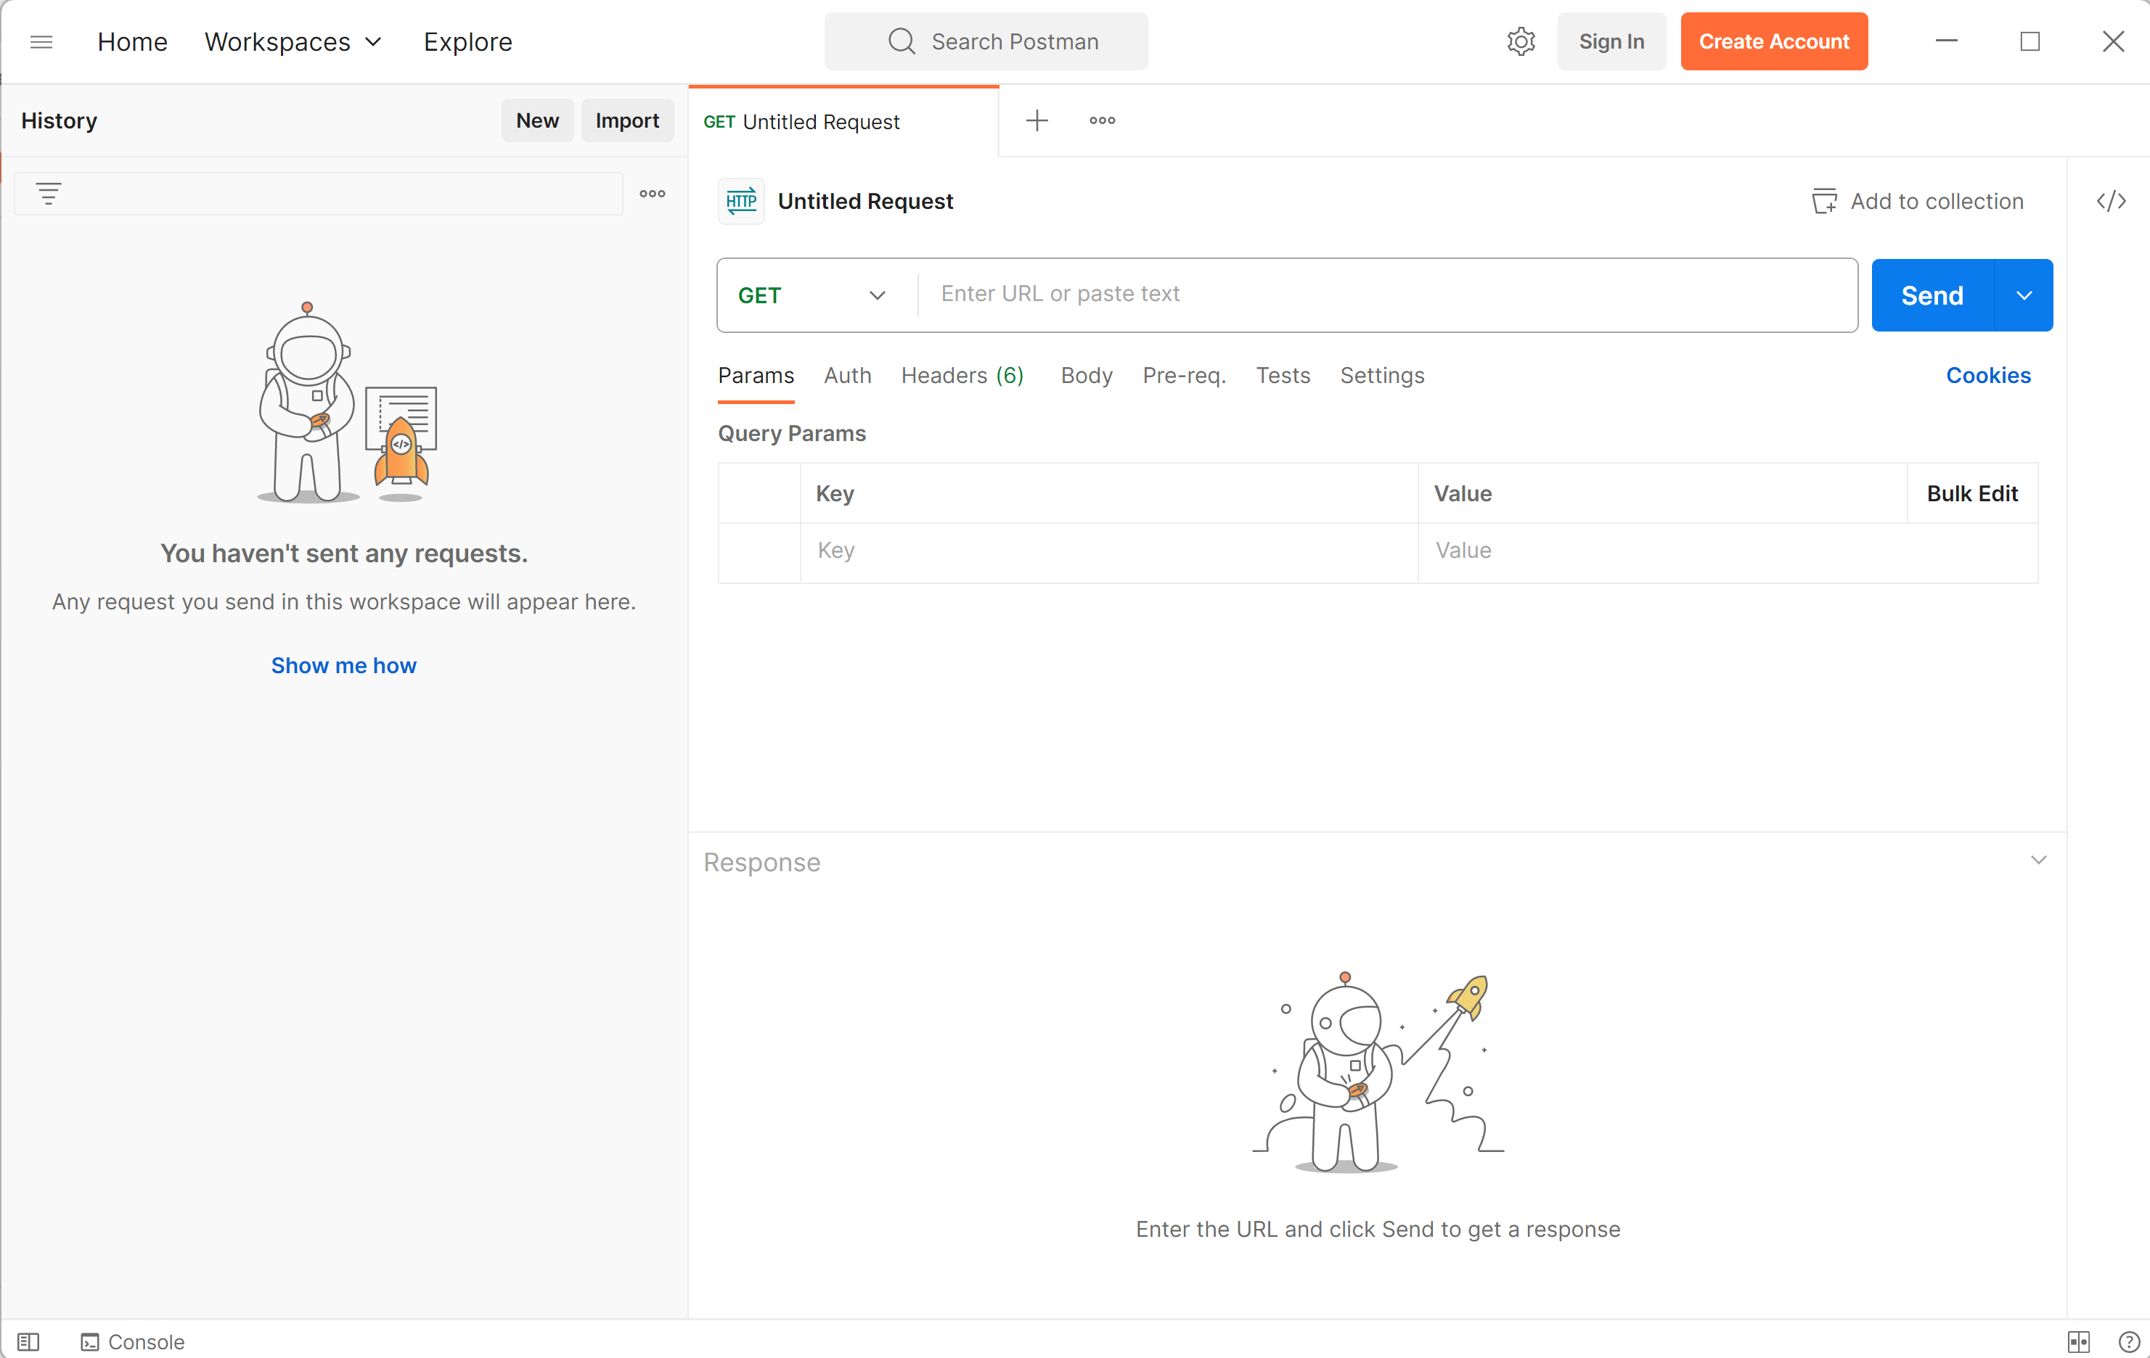
https://www.postman.com/downloads/

Slide 47
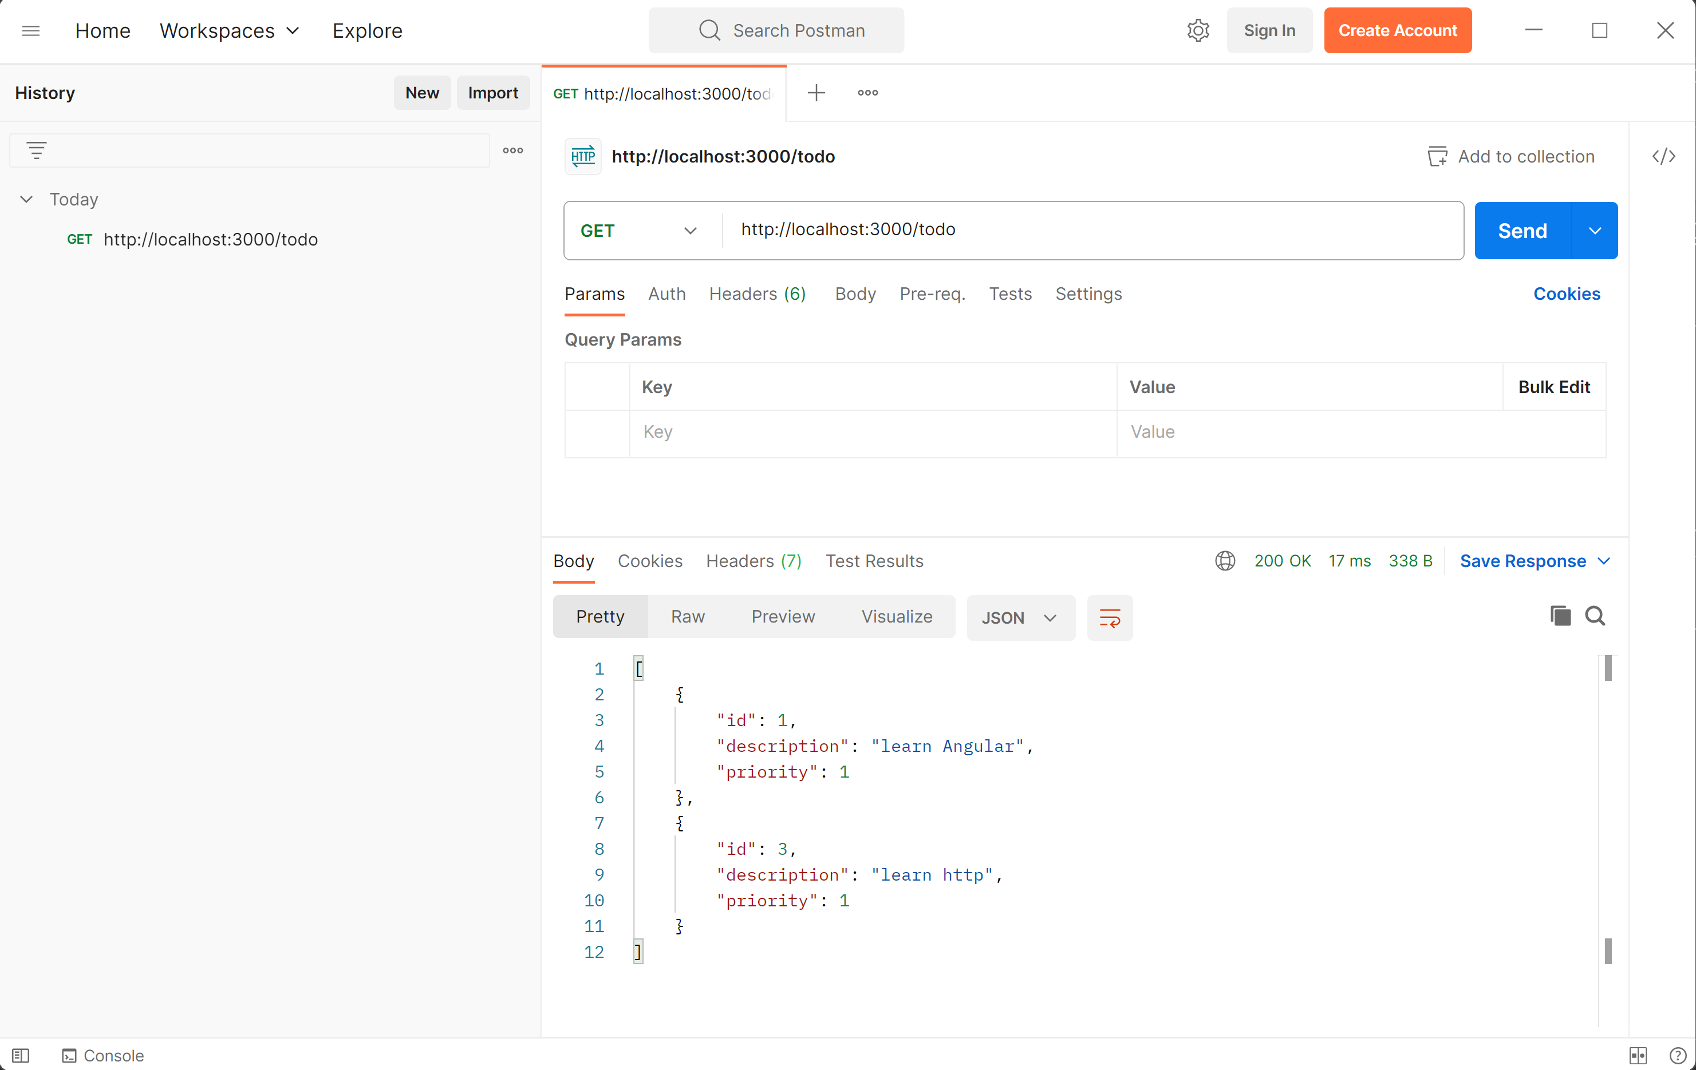
Postman http GET /todo

Slide 48
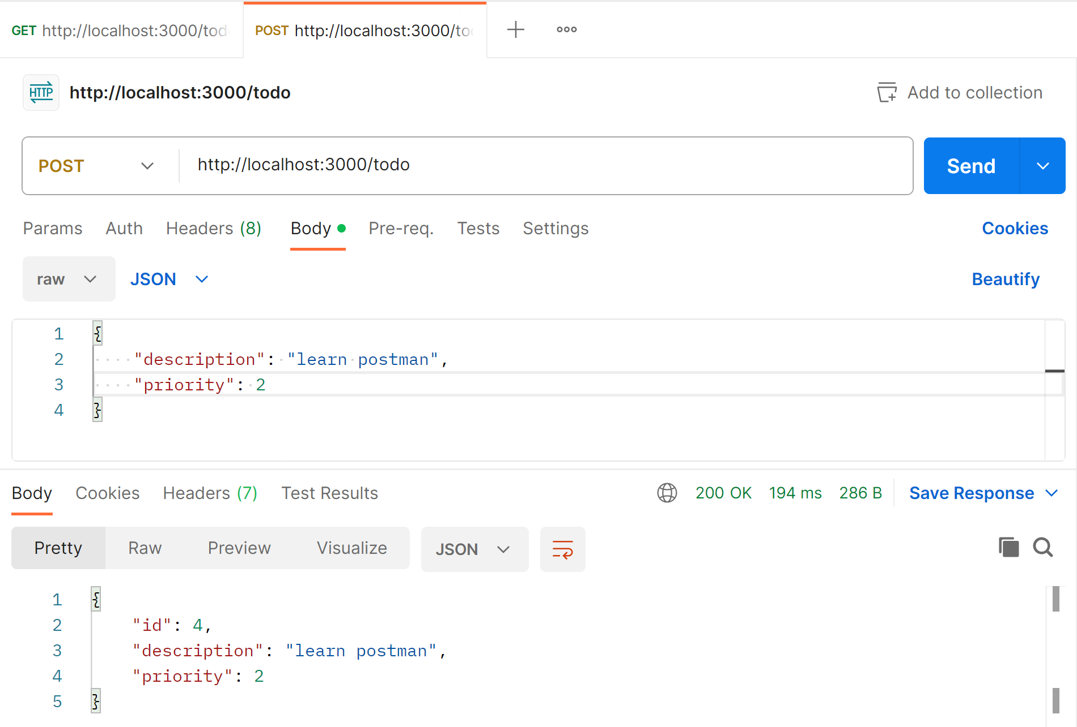
Postman http POST /todo req.body { json}

Slide 49
Demo Outline
Reminder : http client/server, SPA: Single Page Application
Classical Web app tutorial: « Todo web application »
Setup NodeJs + Express
CRUD Rest endpoints :
POST « /todo » {json}
GET « /todo »
GET « /todo/:id »
PUT « /todo » {json}
DELETE « /todo/:id »
Test using Curl
Test using Postman
OpenApi – Swagger UI

Slide 50

Swagger (OpenAPI) https://www.npmjs.com/package/swagger-ui-express + https://www.npmjs.com/package/swagger-jsdoc

Slide 51
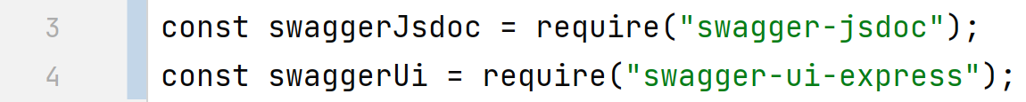
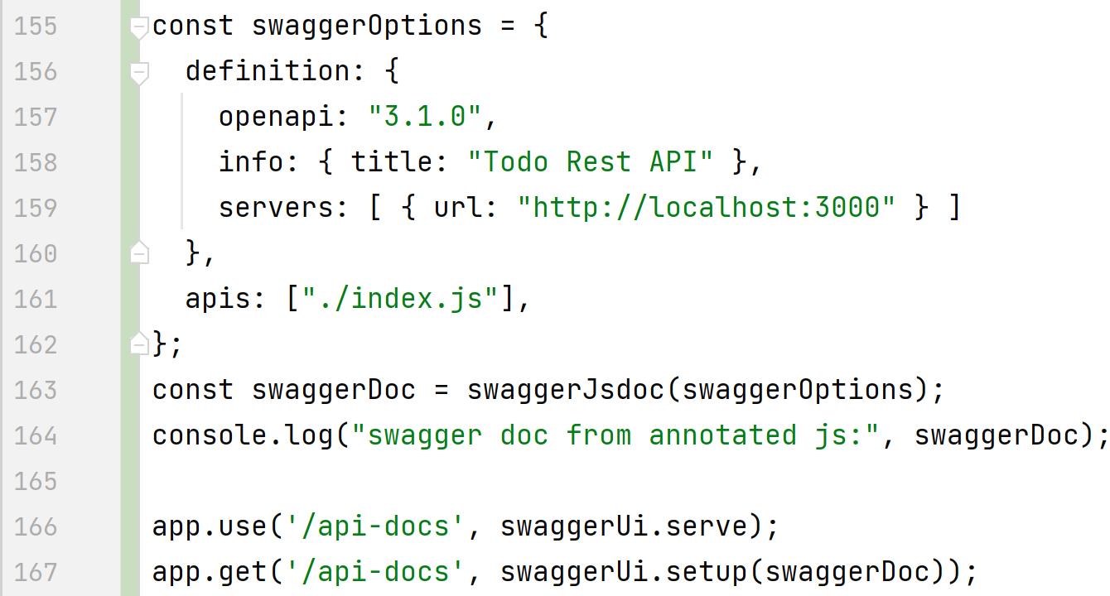
Configuring express + swagger ..

Slide 52
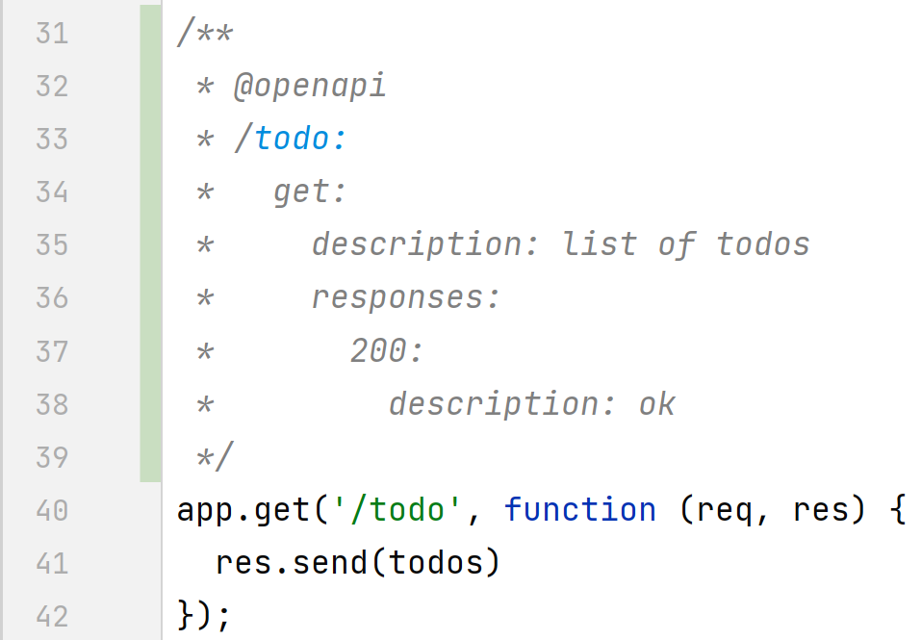
Adding Js Doc: /** @openapi .. */

Slide 53

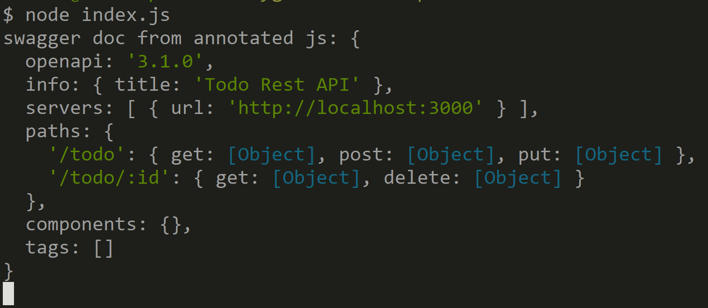
Console.log swagger spec from js doc

Slide 54
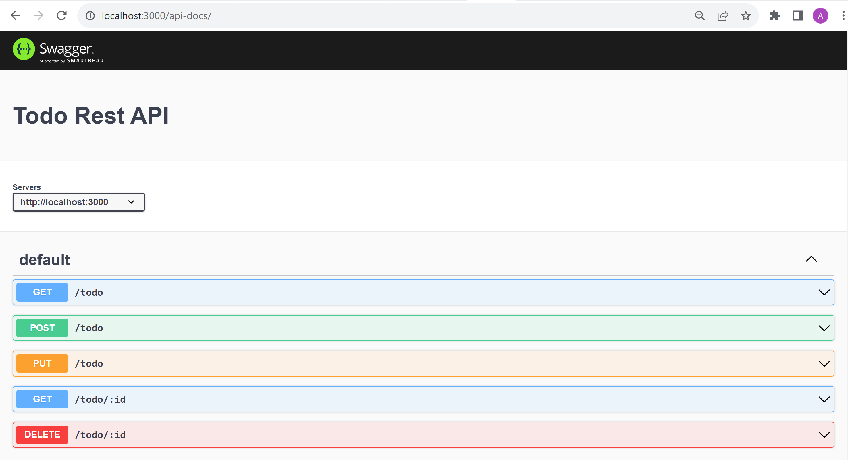
Swagger-UI : http://localhost:3000/api-docs/

Slide 55
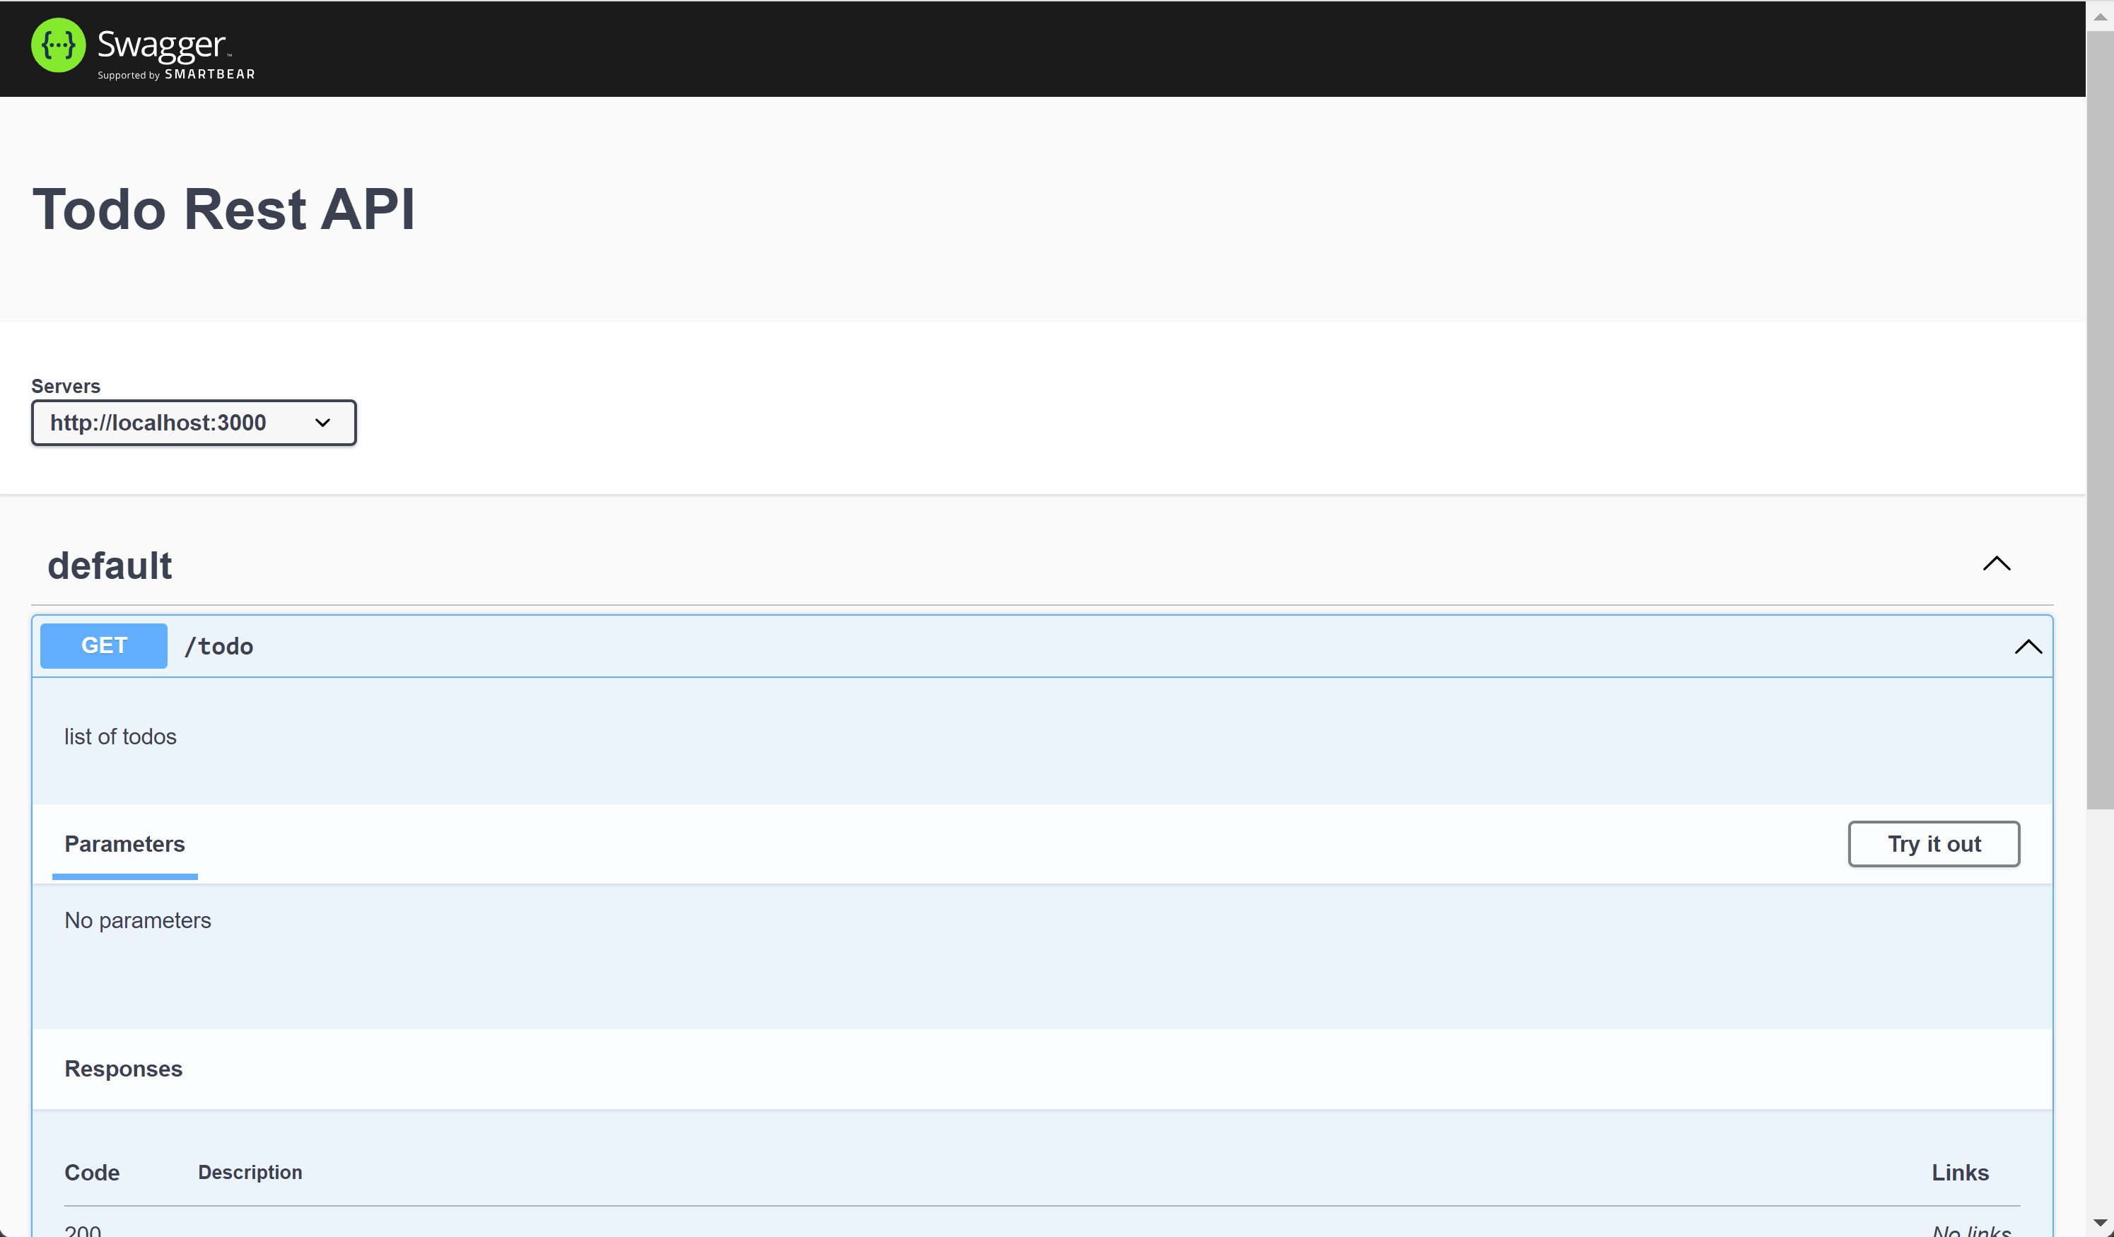
Test using Swagger-UI « Try it out » .. « Execute »

Slide 56
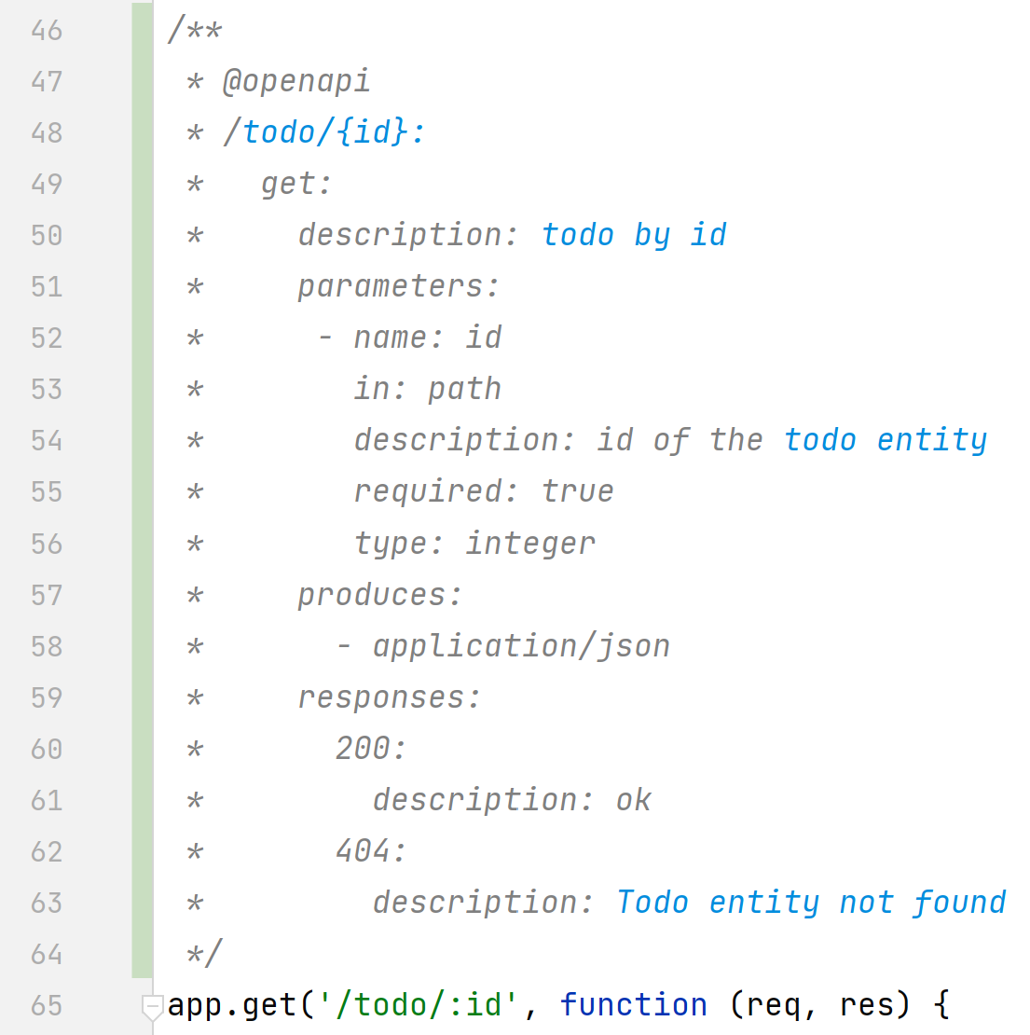
@openapi GET « /todo/{id} » parameters for express « /todo/:id »

Slide 57
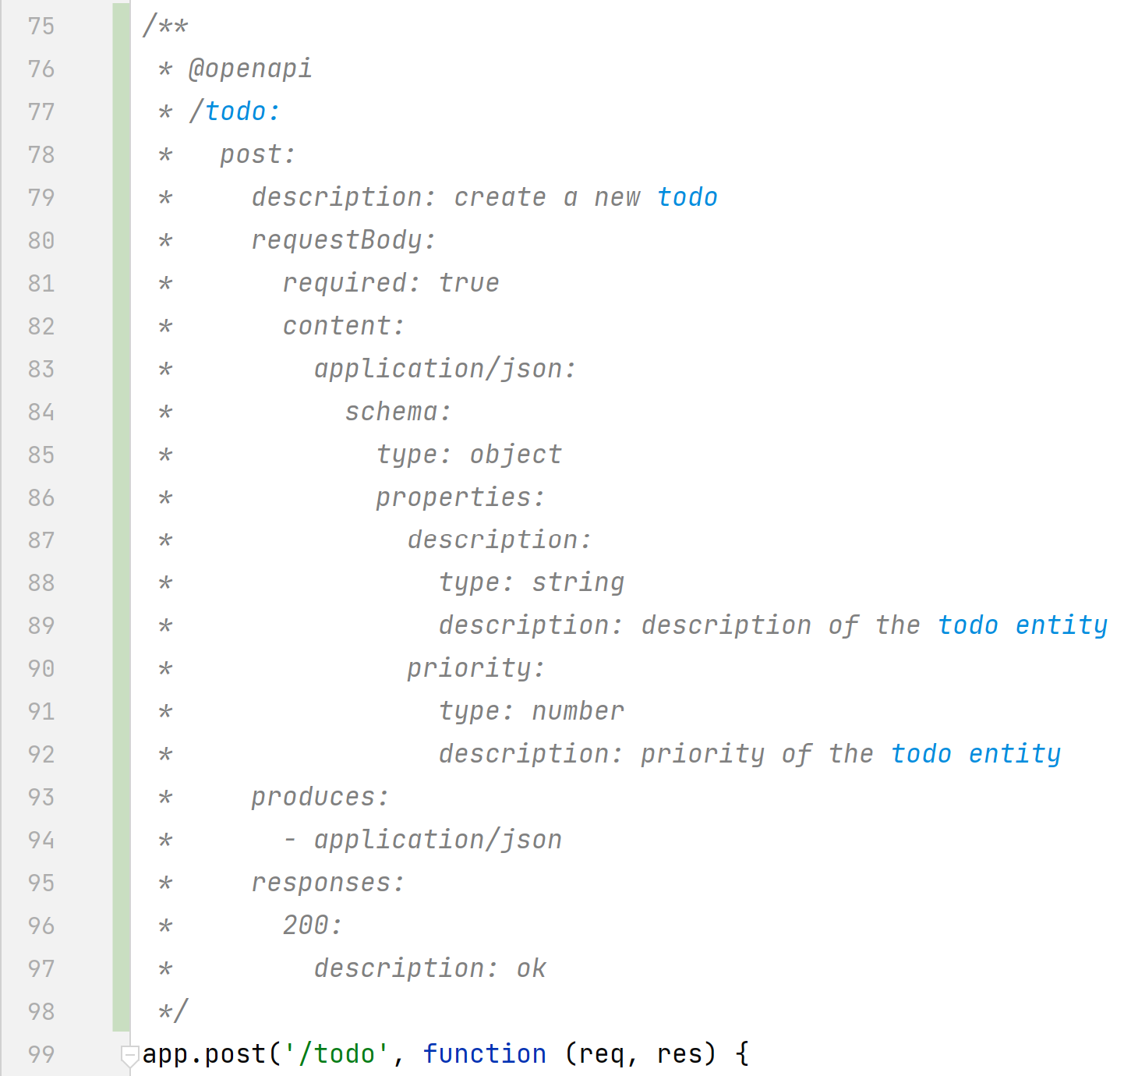
@openapi POST requestBody .. content .. schema

Slide 58
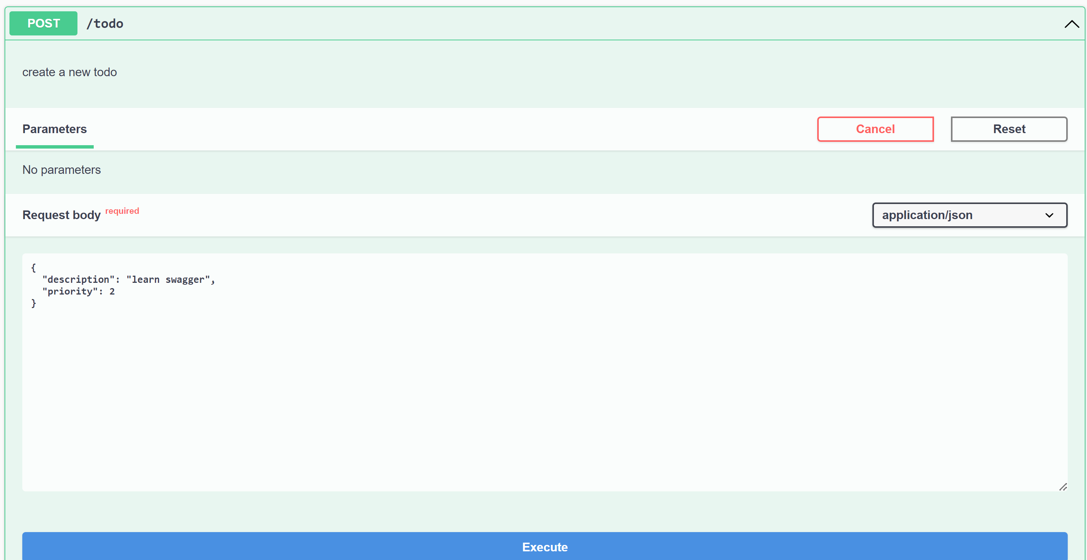
Test Swagger POST with requestBody .. Required json

Slide 59
Demo Outline
Reminder : http client/server, SPA: Single Page Application
Classical Web app tutorial: « Todo web application »
Setup NodeJs + Express
CRUD Rest endpoints :
POST « /todo » {json}
GET « /todo »
GET « /todo/:id »
PUT « /todo » {json}
DELETE « /todo/:id »
Test using Curl
Test using Postman
OpenApi – Swagger UI
Next Steps :
Create Angular FrontEnd App

Slide 60
Take Away
Simple to code a http server
.. even in NodeJS
( better in Java – Springboot
IDE / Debugger / Type checking / Libraries / ..
more valuable for work in companies
)
Rest endpoint = http server using url + json + conventions for state transfer on GET,POST,PUT,DELETE
Use Curl / Postman / OpenApi Swagger

Slide 61
Questions

Slide 62
Next Steps …

